Slide 1
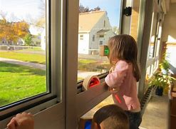
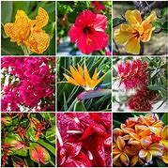
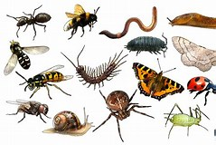
Foundation Stage 2
Mini Beasts and Plants
What’s outside our classroom window?
Summer 1
Go on a mini beast hunt around the school grounds.

Slide 2
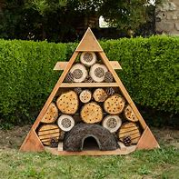
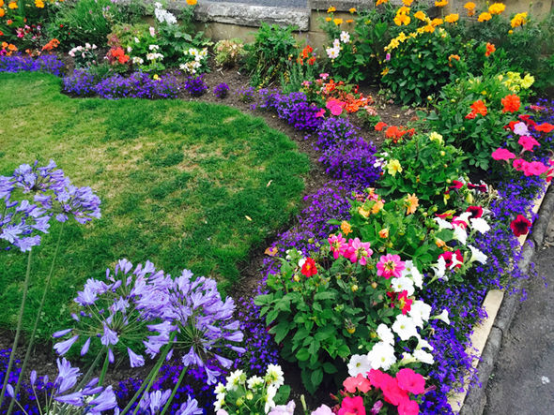
Key Questions
What do we need to grow a plant?
Where do mini beasts live?
What happens if a plant doesn’t get what it needs?
Have you seen any of these creatures before?
What food does a mini beast eat?
Can you talk about different parts of a plant?
How is a mini beast’s home different to where we live?
Why do we have different plants?

Slide 3
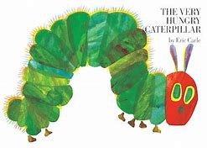
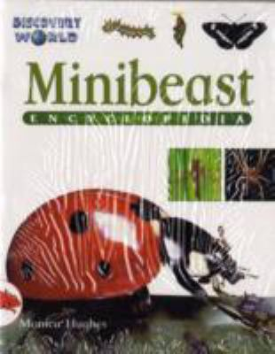
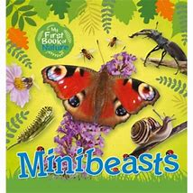
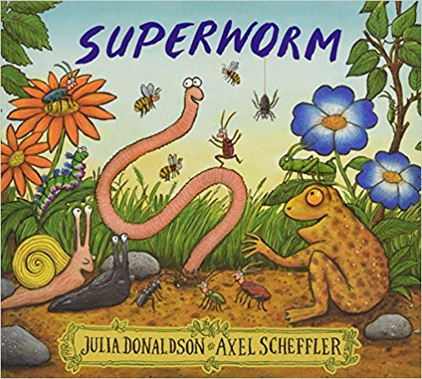
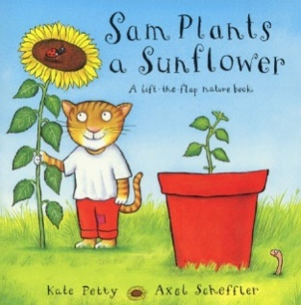
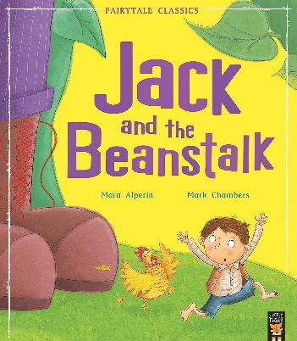
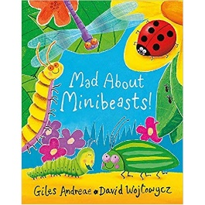
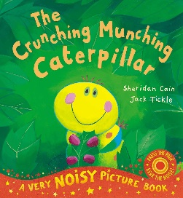
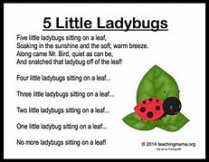
High Quality Texts
Fiction
Non-Fiction
Core Texts
Rhymes and Songs
Incy Wincy Spider
The ants go Marching
Little Miss Muffet
Litter Bug
Multi- media
Insect soundscape on YouTube
Using the class computers/I pads to find facts

Slide 4
Challenge Time
*Queen’s Jubilee – write party invitations and cards to the Queen.
3. Label parts of a flower.
1. Write labels for the body parts of minibeasts.
4. Write a set of instructions on how to plant a bean.
2. Write a fact about minibeasts for a class information book.

Slide 5
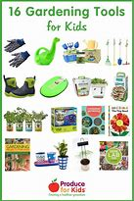
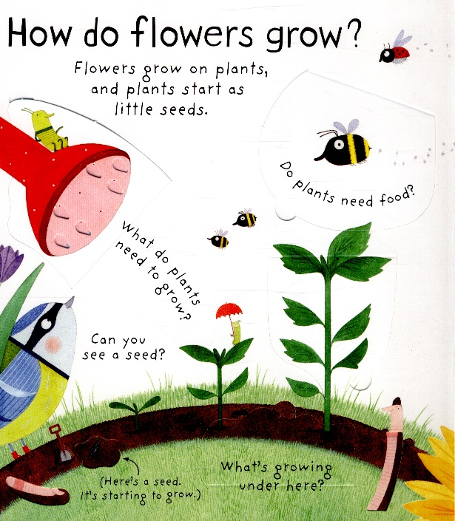
Topic Specific Vocabulary |  | Exploring our environment- Growth and change. | Sticky Knowledge
arachnid | A spider or a scorpion. |  | How plants grow and decay over time. What are the characteristics of the different minibeasts? How do seasons effect our environment?
chrysalis | the transformation from egg to caterpillar to chrysalis and, finally, adult.
bulb | The beginning of a plant, it contains all of the flower and the stem.
nectar | A sugary fluid in plants to encourage pollination.
pollen | A yellow powder that pollenates other plants.
 |  | How to use gardening equipment safely. How do plants grow?

Slide 6
Writing Features
Write short sentences with words with known letter-sound correspondences using a capital letter and full stop.
To re-read what they have written to check that it makes sense.
be interested
Spell words by identifying the sounds and then writing the sound with letter/s
Audience and Purpose:
Research about the farm, writing captions and making a class book
Form lower case and capital letters correctly
Write some letters accurately
Write simple phrases and sentences that can be read by others.

Slide 7
What’s outside our classroom window?
1. Labelling different parts of a mini beast.
3. Label the parts of a flower.
Summer 1 term
In English, we will be writing…
2. Write a fact file about minibeasts for a class information book.
4. Write a set of instructions on how to plant a bean.

Slide 8
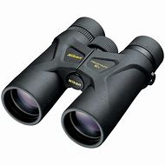
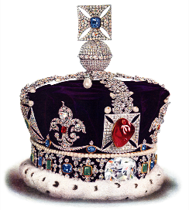
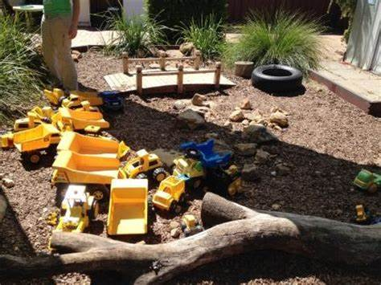
We are creative
Make a…
Sketch a…
What’s outside our classroom window?
Build a…
Construct a…
Design a …
Plan a…
Queen’s Jubilee

Slide 9
Dear Parents and carers,
Here is our topic for this half term. Please also see the Creative Homework sheet for ideas about supporting your child’s Learning Journey. Have Fun!
Sharing our learning
What’s outside our classroom window?
Reception: What’s outside our classroom window?
:
Children’s ideas:
Build our very own mini beast hotel!
Design and create a planting area to maintain throughout the year.
Wow Event/Hook
Minibeast hunt and welly walk!
Topic Outcome
For children to explore the outdoors.
For the children to be involved in the development of out outdoor learning area.
As Musicians we will:
Learn new songs about minibeasts.
Make up our own songs.
Learn about the dynamic and tempo in music.
As Readers we will:
Enjoy a wide range of books.
Hunt for common words in books.
Talk about what we have read.
Read sentences with fluency.
Read facts from non fiction books.
As researchers we will:
Find out facts about mini beasts.
Discover where animals live.
As a computer expert we will:
Use and interact with age appropriate computer software.
Understand that a range of technology is used in places such as home and school.
As PE superstars we will:
Handle equipment and tools effectively and with increasing control.
Move confidently in a range of ways, safely negotiating space.
Understand how to keep safe and healthy.
As Authors we will:
Write labels and captions.
Segment sounds for writing simple and more difficult words.
Write a sentence with finger spaces, capital letters and full stops.
Begin to write stories.
As Artists/Designers we will:
Design and create our own pieces of art work to share with our friends.
Learn the skill of sketching.
To review and improve our art work.
As Citizens we will:
Learn how to care for living things.
Work together, listen to each other and build on each other’s ideas.
As Scientists we will:
Make observations of animals and plants, observations of change and explain why some things occur.
Discuss and record our observations and make scientific predictions.
As Mathematicians we will :
Count reliably with numbers from 1-20 and beyond.
Learn about doubling and halving.
Use the ‘part part whole’ model
Talk about size, weight, capacity, position, distance, time and money.
Explore number bonds and tens frames.

Slide 10
Dear Parents and carers,
This term we are learning all about growth and change in our local environment. Please support your child in choosing at least one project to complete. If you would like to do more, that would be great!
You can bring this into school whenever you have completed your project.
If you have any questions, please ask your child’s class teacher.
Thank you for your support.
What’s outside our classroom window?
Project 4- I am a Designer.
Can you design and create a mini beast hotel for your own garden?
Bring in any pictures you have to show case your work.
Creative Homework
Summer 1
FS2
Project 1 – I am a Writer
Can you find out information about your favourite minibeast? Write a fact file!
Project 5 – I am a Scientist
Why not grow your own plants at home? Record the changes that happen over time.
We would love to see some photographs.
Project 3 – I am an Artist
Have a go at creating a 3D minibeast at home, you could use junk modelling, paint, clay. Be as creative as you can.
Project 2 – I am a Mathematician
Can you explore 2D and 3D shapes around your home? What can you find? Record them.

