Slide 1
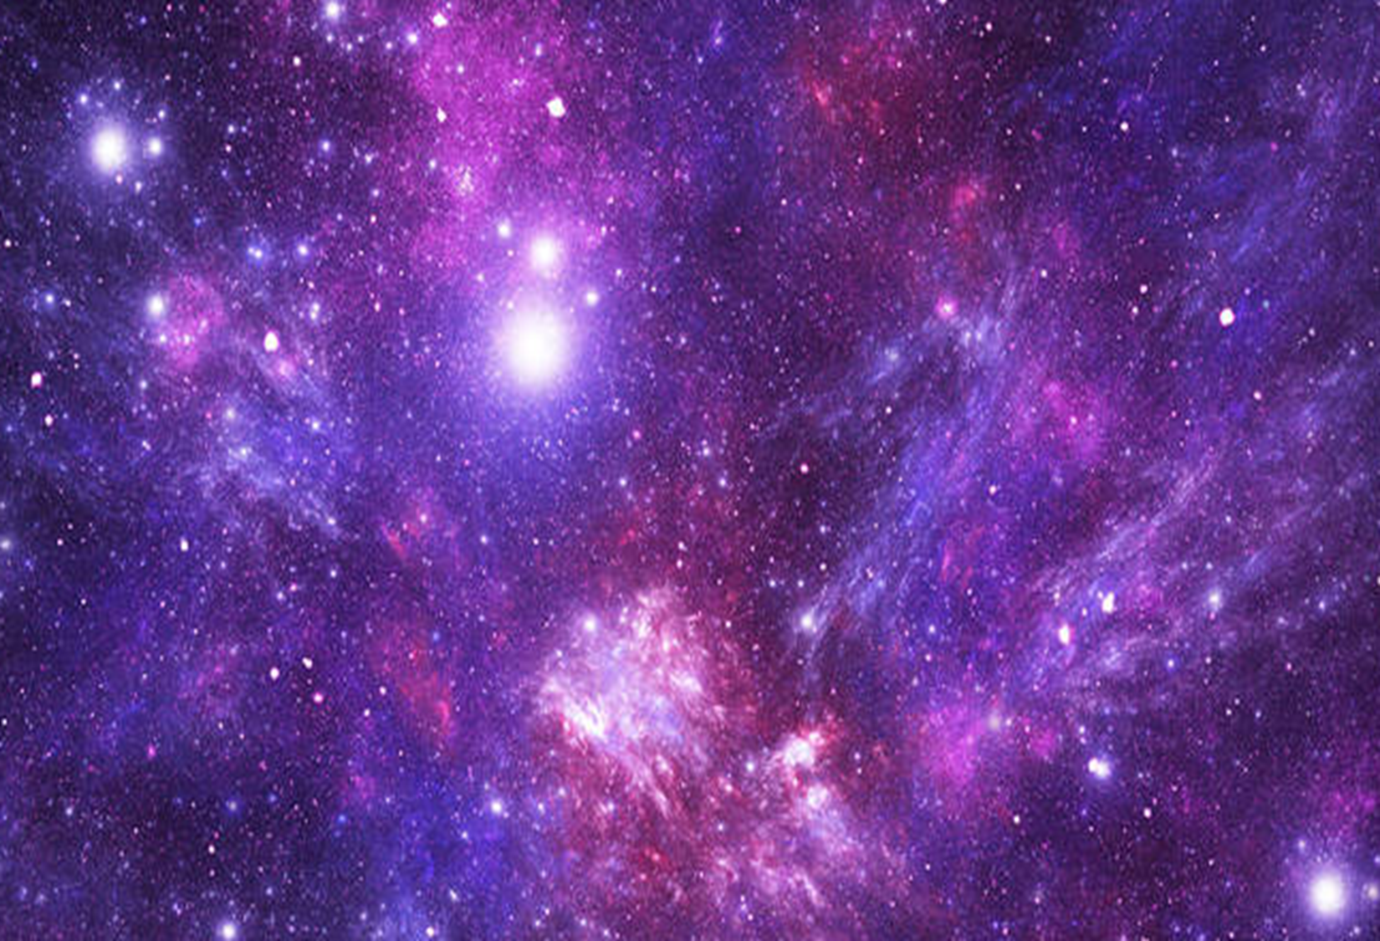
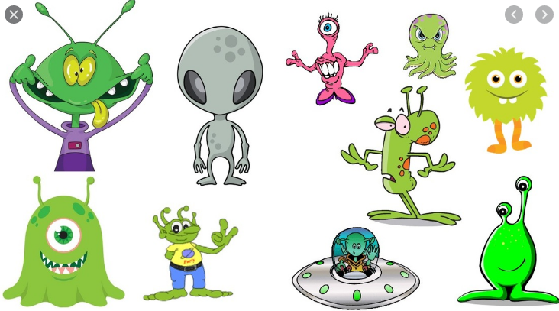
Dear Parents and carers,
Please support your child in choosing one or more projects to complete.
Please email completed work to year1@cavclosei.derby.sch.uk or bring it into school by 25th May 2022.
If you have any questions, please ask your child’s class teacher.
Thank you.
Would you like to go to alien school?
Creative Homework
Summer Term 1
Year 1
Project 4 - I am a Designer
Create your own space vehicle using art and DT materials. You could include aliens and astronauts to fly them.
Project 1 – I am a Writer
Write about Neil Armstrong and what he is most famous for? You could write about what it’s like to be an astronaut and what your jobs might be in space?
Project 3 – I am an Artist
Draw, paint or create a 3D picture of a space scene. Can you include different things like planets, the moon, stars, or even the milky way?
Project 5 – I am a Scientist
Be a moon expert! Keep a diary of the moon for a week. What happens to the moon, does it change?
Project 2 – I am a Mathematician
Practice being in the space rocket control room and count down from 20. Can you count down from 50 or 100 too?
Project 6 – I am a Geographer
Look in non-fiction books and find out what our planet looks like from space. Draw what might you see?

