Slide 1
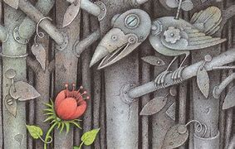
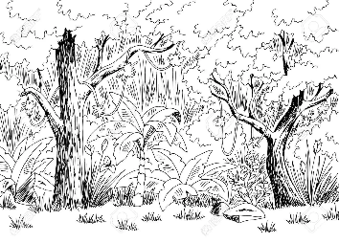
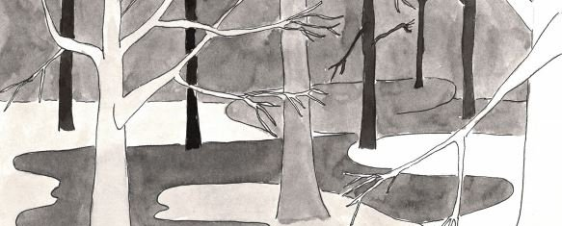
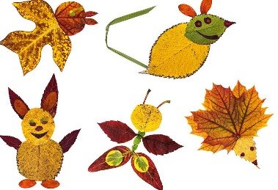
Dear Parents and carers,
This term our topic is about our environment! Please support your child in choosing at least one project to complete. If you would like to do more, that would be great!
The final date to send in the project is Friday 20th May. Please bring in your work or email us photos of your children’s achievements so we can celebrate these in our classes.
If you have any questions, please ask your child’s class teacher.
Thank you for your support.
We care about our environment!
Project 5
Using only a pencil draw a black and white sketch of a rain forest. How many shades of grey can you make? How many different textures can you draw? Add shading for shadows and rub out parts for highlights.
Creative Homework
Summer Term 1 Year group 2
Project 1:
Make a model of a rainforest using recycled materials.
Project 6
Create an artwork including the union jack flag to celebrate the Queens Jubilee. For example a flag or banner.
Project 4
Use recycled materials to create a musical instrument that could make sounds of the rainforest. For example using lentils in a pringles tube.
Project 2:
Make a picture
using different
leaf types. Can
you name and
identify them.
Project 7
Use your imagination to create a 3D scultpture of an animal you would find in a rainforest. Such as a toucan, tiger, snake.
Project 3: Make up a song using the words ‘Reduce, Reuse, Recycle

