Slide 2
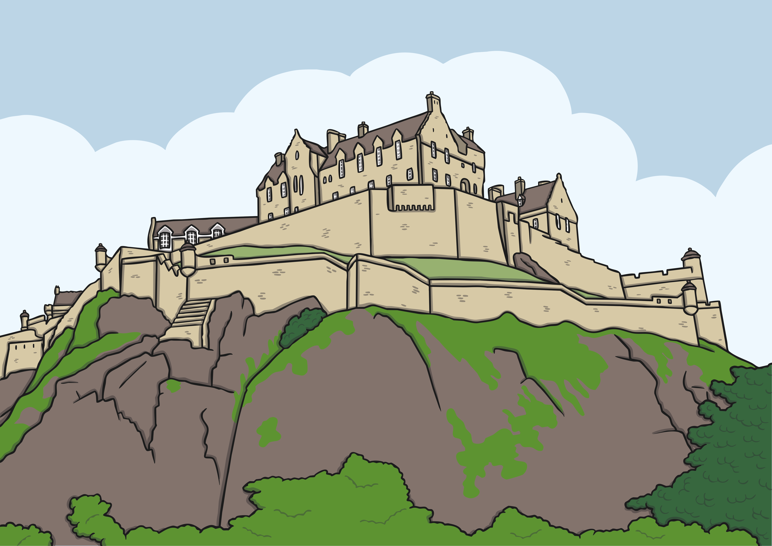
What Is a Castle?
Castles are strong buildings, often made out of stone. They were built a long time ago for important people.
Castles were lived in by the important people, their families and servants. Castles protected people from attacks. Some castles were very big and grand, in order to show how much money the important person had.

Slide 3
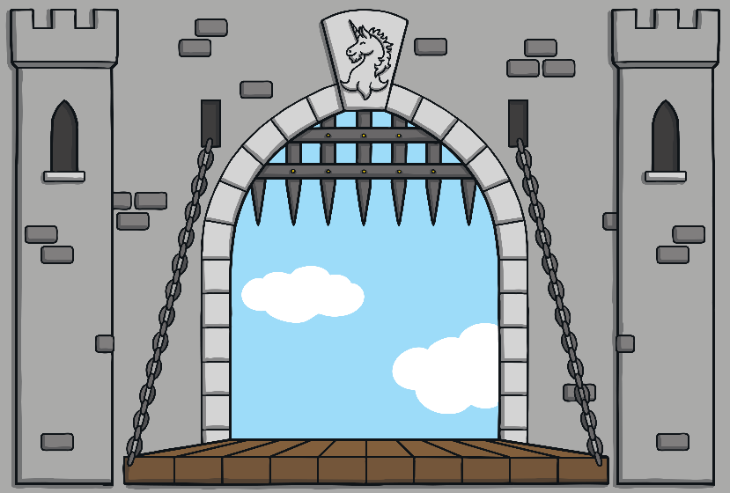
How Were Castles Designed?
Castles were often built on hills. This meant attackers could be seen in plenty of time.
Some castles were built in the middle of a small lake. This lake was called a moat. The only way to get into these castles was across a special bridge called a drawbridge. The drawbridge could be pulled up to stop people getting into the castle.
Castle walls were thick and usually made of stone. This protected the people inside the castle.
Castle drawbridge

Slide 4
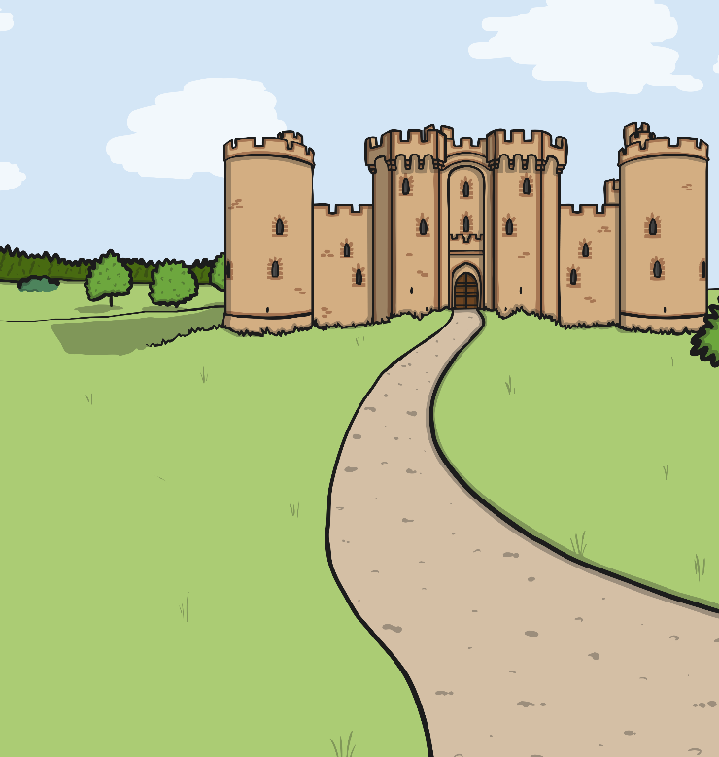
Castles Today
Over time, some castles stopped being lived in. Today, some of them are in ruins, while others are still working buildings.
There are lots of castles that can be visited, both castles that are ruins and those that are still lived in.
Talk About It
Have you ever visited a castle?

Slide 5
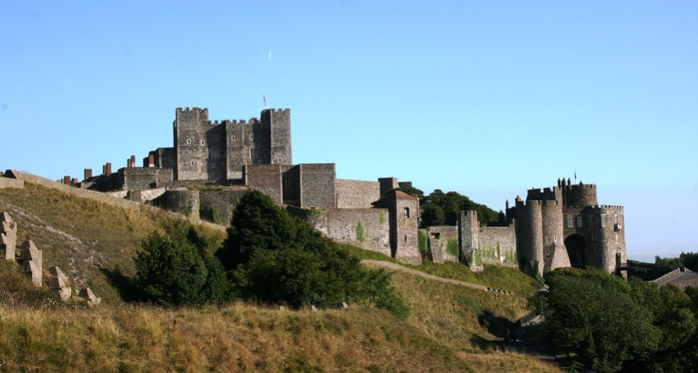
Dover Castle
Dover Castle is in Kent in England. It started being built almost nine hundred years ago by a king called Henry II. Other kings and important people added more parts to the castle over 800 years. As the castle was by the sea, it was an important part of protecting England from attacks from other countries.

Slide 6
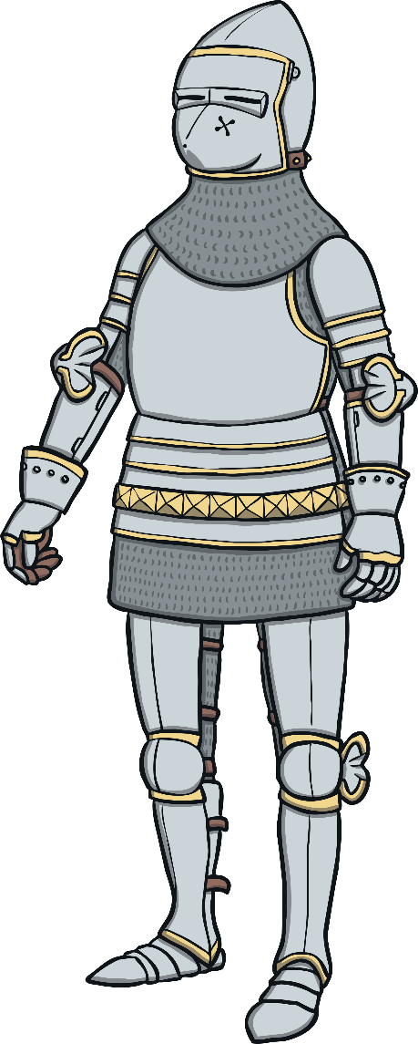
Did You Know?
These tunnels have been important at different times.
There are secret tunnels underneath Dover Castle.
During the Second World War (when lots of countries across the world were fighting), soldiers went on secret missions in the tunnels.

Slide 7
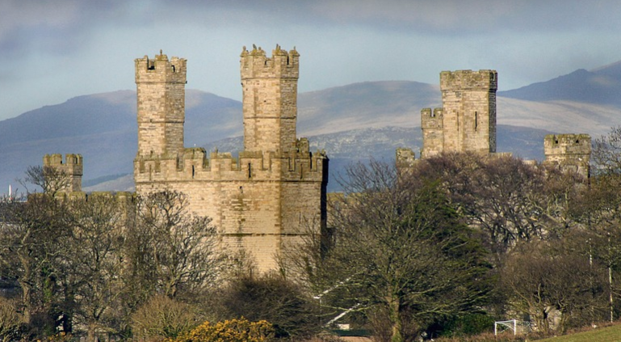
Caernarfon Castle
Caernarfon (say Car-nar-von) Castle is in the town of Caernarfon in Wales. A king called Edward I decided that the castle should be built over 700 years ago. Edward I was English but had taken over parts of Wales. The castle was to be a way of keeping control of Wales. Hundreds of years later, bits of the castle began to turn to ruins. You can visit Caernarfon Castle.

Slide 8
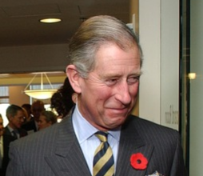
Did You Know?
Today, this name is usually given to the oldest son of the British King or Queen.
Edward I’s son was given the title ‘Prince of Wales’.
Prince Charles is now the Prince of Wales. He was given his special name at an event at Caernarfon Castle.
Prince Charles

Slide 9
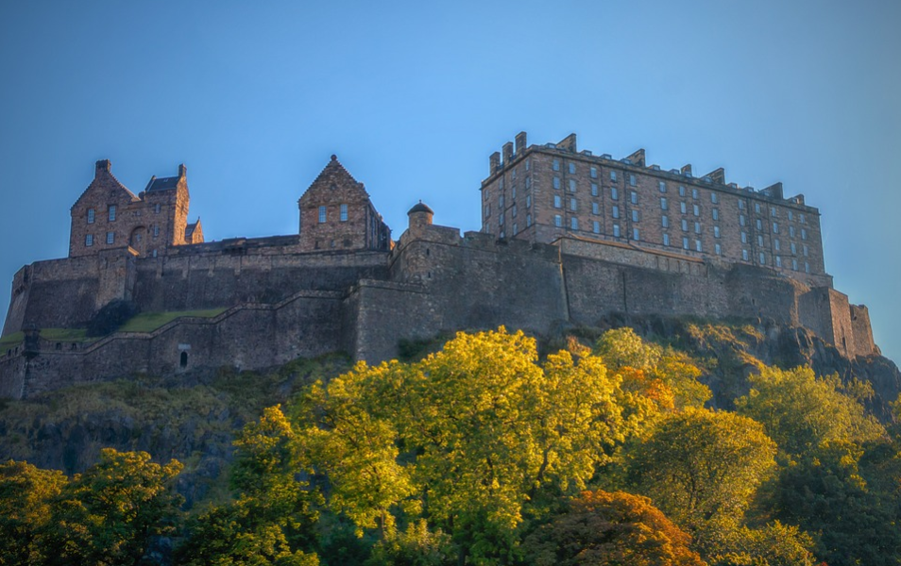
Edinburgh Castle
Edinburgh Castle is in Edinburgh, Scotland. It was built on a tall hill called Castle Rock. The first Edinburgh Castle was built almost 1000 years ago! It was an important part of Scottish defence hundreds of years ago, when Scotland and England fought wars against each other.

Slide 10
Did You Know?
In Edinburgh Castle, there is a special stone called the Stone of Destiny. Lots of kings and queens have sat on this stone when they became king or queen and were given their crown.
At the castle, there are special jewels called the Honours of Scotland, which were made for the King of Scotland.

Slide 11
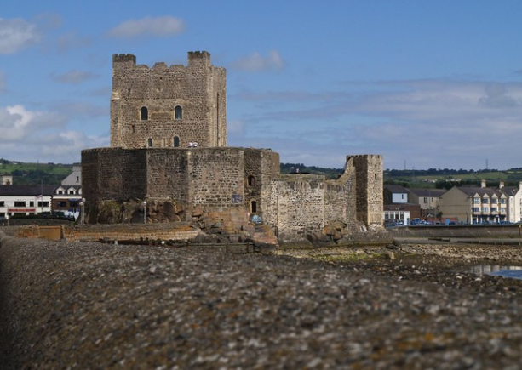
Carrickfergus Castle
Carrickfergus Castle is in County Antrim, Northern Ireland. It was built over 800 years ago by a knight called John de Courcy. It is on the edge of a river called Belfast Lough. Most of the castle was surrounded by the water, which made it easier to defend from attackers. It was part of battles involving Scotland, England, Ireland and France.
“Carrickfergus Castle” by [Perica] is licensed under CC BY 2.0

Slide 12
Did You Know?
In the First World War, Carrickfergus Castle was used as a place for soldiers to stay. In the Second World War, the castle was used as an air raid shelter. People could go to the castle to protect themselves from bombs being dropped from aeroplanes.

Slide 13
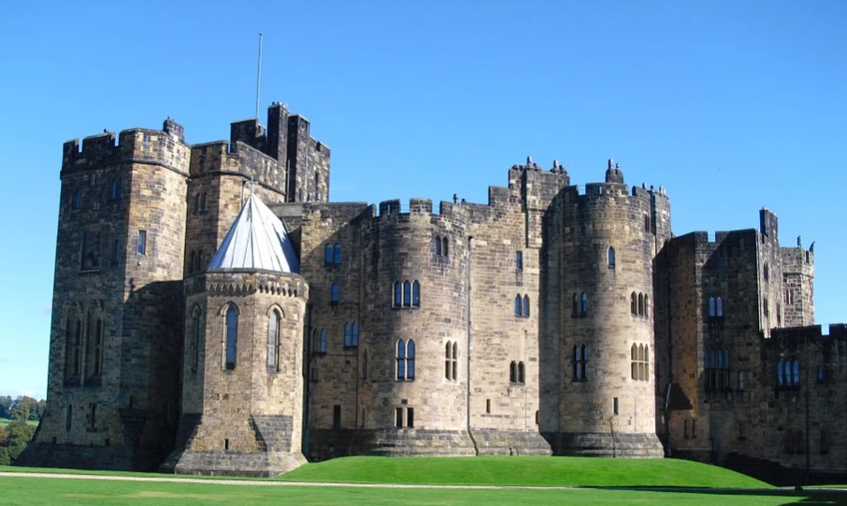
Alnwick Castle
Alnwick Castle is in Northumberland, England. Over 700 years ago, a man named Henry Percy bought the first building and turned it into a castle. The Percy family still live in Alnwick Castle and Ralph Percy is also called the Duke of Northumberland. Alnwick Castle played a part in some important battles including a war between two Royal families called the War of the Roses.

Slide 14
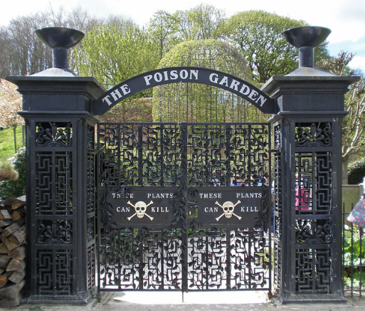
Did You Know?
You might recognise part of Alnwick Castle – it was used to film scenes from the Harry Potter films.
Alnwick Castle has lots of gardens. One of these is called the Poison Garden and it is full of deadly plants!
“The Alnwick Garden” by [Amanda] is licensed under CC BY 2.0

Slide 15
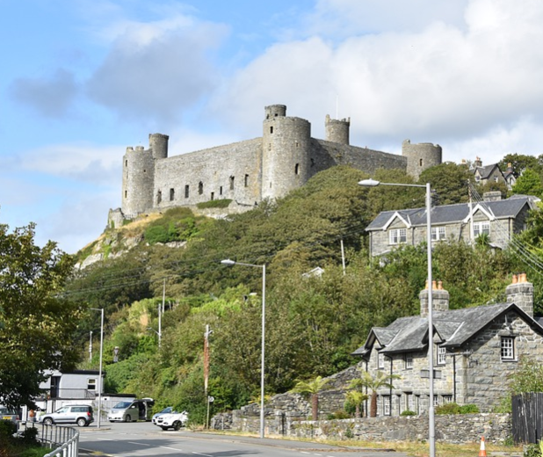
Harlech Castle
Like Caernarvon Castle, Harlech Castle was built when Edward I was king. It was built as lots of walls built inside each other, which made it easy to defend from attackers. Although the castle is high up a hill and very big, it only took seven years to build. At the time, other castles were built over hundreds of years!

Slide 16
Did You Know?
Going up the steep cliff leading from the river to the castle are 108 narrow steps called ‘Way from the Sea’.
When the castle was surrounded by attackers for many months, food, drink and weapons could still be brought to the people inside the castle.

Slide 17
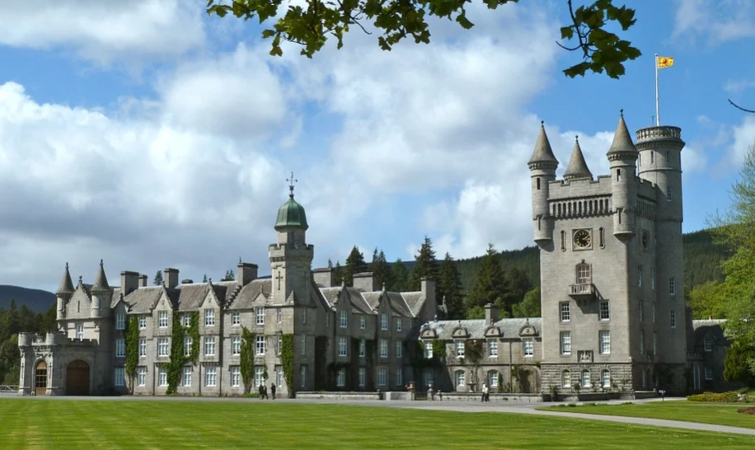
Balmoral Castle
Balmoral Castle is in Aberdeenshire, Scotland. There was an older castle in the area, but in 1853, Queen Victoria bought the land and had a new castle built instead. Can you see the flag in this photo? This is called the Royal Standard and it is flown from a building when the Queen is there.

Slide 18
Did You Know?
A new Balmoral Castle was built because the older one wasn’t big enough for Queen Victoria and her family – she had nine children!
As well as the castle, Balmoral has more than 150 other buildings.

Slide 19
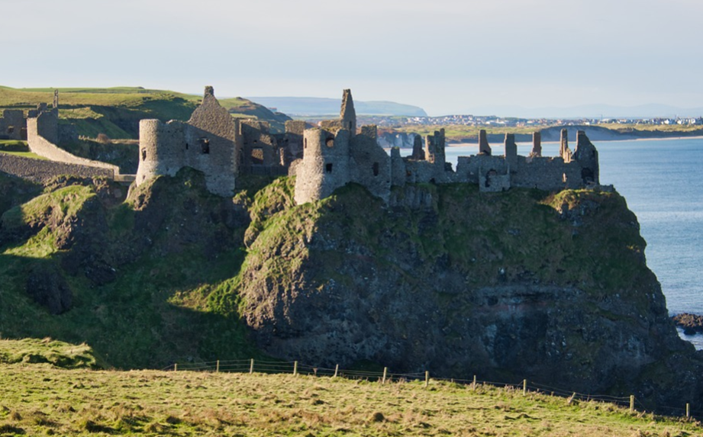
Dunluce Castle
Dunluce Castle is in Country Antrim, Northern Ireland. It was built over 500 years ago by the MacQuillan family. Not long after it was built, another family, called the MacDonnell clan, fought the MacQuillans and took control of the castle. The castle was surrounded by high cliffs. Today, the castle is in ruins, although people can visit it and look around.

Slide 20
Did You Know?
A story is told that one day part of the castle kitchen fell into the sea and that after that, the wife of the owner refused to live in the castle any more.
There is also a spooky story about ‘The Banshee of Dunluce Castle’. The banshee is meant to be the ghost of Maeve MacQuillan who lived in the castle hundreds of years ago.

Slide 21
Would you like to visit any of these castles? If so, which ones would you like to visit and why?
If you were going to build a castle, where would you build it? What would you build it from? Who would live in your castle with you?

