Slide 1
Monday

Slide 2
Revisit and Revise Practise reading these ‘flash words’
will
when
ask
full
like
push
pull

Slide 3
Revisit and Revise Practise reading these ‘off by heart’ words’
your
friend
house
once
today
little

Slide 4
Revisit and Revise
Practise reading these graphemes.
ee
igh
air
ear
oa
ure
oo
Can you find them on your Big Cat chart?

Slide 5
Teach
Look at the new grapheme.
Say it!
Say it to the window, say it to the door, say it to the ceiling, say it to the floor.
Look at it. Use your magic finger to write it in the air.
oi
as in the word ‘boil’

Slide 6
Teach
Look at the new grapheme
‘ori likes to come in the middle or at the beginning of words.
oi

Slide 7
Smooth blend these words
Practise
My turn ...
Together ...
Your turn ...
toil
doip
foil
poison
shoib
boil
Word building
Smooth blend
woiz
coin
goif

Slide 8
Practise
Blending to read
Practise blending the words containing ‘oi’ by playing ‘Buried Treasure’.

Slide 9
Apply
Blending to read sentences
A plants roots are underground in the soil.
The girl found a coin in a pot in the garden.
The sun is boiling hot in Summer.

Slide 10
Monday Afternoon

Slide 11
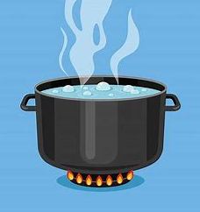
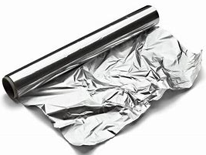
Apply
Segmenting to spell
Can you write the words to match these pictures?
oi

Slide 12
Apply
Segmenting to spell
How did you do?
Reach for the stars – Can you write the words in a sentence?
oi
foil
boil
coins

Slide 13
Apply
Reading Books
Blend to read the words in this Collins Big Cat book.

Slide 14
Tuesday

Slide 15
Revisit and Revise Practise reading these ‘flash words’
will
when
ask
full
like
push
pull

Slide 16
Revisit and Revise Practise reading these ‘off by heart’ words’
your
friend
house
once
today
little

Slide 17
Revisit and Revise
Practise reading these graphemes.
ee
igh
air
ear
oa
ure
oo
Can you find them on your Big Cat chart?

Slide 18
Teach
Look at the new grapheme. It can make two phonemes.
Say it!
Say it to the window, say it to the door, say it to the ceiling, say it to the floor.
Look at it. Use your magic finger to write it in the air.
ew
as pronounced in the word ‘chew’ and ‘stew’

Slide 19
Teach
Look at the new grapheme
‘ew’ likes to come at the end of words and sometimes in the middle.
ew

Slide 20
Practise reading these words.
Practise
My turn ...
Together ...
Your turn ...
stew
flew
snew
Cover the word and reveal it 1 sound at a time. As you see a sound say it and add it to what you have read already.
plew
chew
pew
Word building
Smooth blend
gewn
threw
newt

Slide 21
Practise
Blending to read
Practise blending words containing ‘ew’ by playing ‘Dragon’s Den’ on ‘Phonics Play’.

Slide 22
Apply
Blending to read sentences
The strong wind blew the trees branches and twigs.
The sunflower grew to be big and tall.
The grass is damp when it has dew on it in the morning.

Slide 23
Tuesday Afternoon

Slide 24
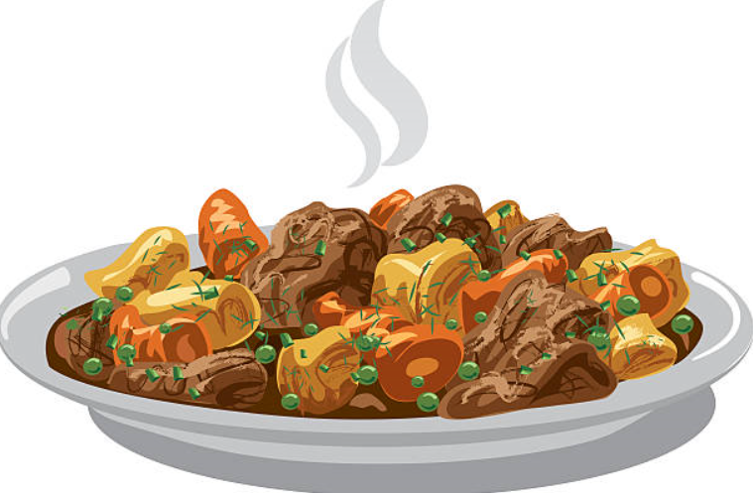
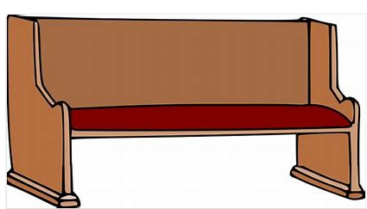
Apply
Segmenting to spell
Practise spelling words containing ‘ew’. Can you write the words to match these pictures?
ew

Slide 25
Apply
Segmenting to spell
Practise spelling words containing ‘ew’. Can you write the words to match these pictures?
ew
dew
stew
pew

Slide 26
Apply
Reading Books
Blend to read the words in this Collins Big Cat book.

Slide 27
Wednesday

Slide 28
Revisit and Revise Practise reading these ‘flash words’
will
when
ask
full
like
push
pull

Slide 29
Revisit and Revise Practise reading these ‘off by heart’ words’
your
friend
house
once
today
little

Slide 30
Revisit and Revise
Practise reading these graphemes.
ee
igh
air
ear
oa
ure
oo
Can you find them on your Big Cat chart?

Slide 31
Teach
Look at the new grapheme.
Say it!
Say it to the window, say it to the door, say it to the ceiling, say it to the floor.
Look at it. Use your magic finger to write it in the air.
aw
as pronounced in the word ‘saw’

Slide 32
Teach
Look at the new grapheme
‘aw’ likes to come at the beginning, middle and end of words.
aw

Slide 33
Practise reading these words.
Practise
My turn ...
Together ...
Your turn ...
saw
lawn
traw
Cover the word and reveal it 1 sound at a time. As you see a sound say it and add it to what you have read already.
splaw
yawn
draw
Word building
Smooth blend
paws
glaw
awful

Slide 34
Practise
Blending to read
Practise blending words containing ‘aw’ by playing ‘Picnic on Pluto’ on ‘Phonics Play’.

Slide 35
Apply
Blending to read sentences
In August the grass on the lawn will be long.
Can you draw all the parts of a plant?
The cat saw a flower and felt it with her paw.

Slide 36
Wednesday Afternoon

Slide 37
Apply
Segmenting to spell
Practise spelling words containing ‘aw’. Can you write the words to match these pictures?
aw

Slide 38
Apply
Segmenting to spell
How did you do?
Reach for the stars – Can you write the words in a sentence?
aw
yawn
paw
draw

Slide 39
Apply
Reading Book
Blend to read the words in this Collins Big Cat book.

Slide 40
Thursday

Slide 41
Revisit and Revise Practise reading these ‘flash words’
will
when
ask
full
like
push
pull

Slide 42
Revisit and Revise Practise reading these ‘off by heart’ words’
your
friend
house
once
today
little

Slide 43
Revisit and Revise
Practise reading these graphemes.
ee
igh
air
ear
oa
ure
oo
Can you find them on your Big Cat chart?

Slide 44
Teach
Look at the new grapheme.
Say it!
Say it to the window, say it to the door, say it to the ceiling, say it to the floor.
Look at it. Use your magic finger to write it in the air.
oe
as pronounced in the word ‘toe’

Slide 45
Teach
Look at the new grapheme
‘oe’ likes to come at the end of words and sometimes in the middle.
oe

Slide 46
Practise reading these words.
Practise
My turn ...
Together ...
Your turn ...
toe
goes
troe
Cover the word and reveal it 1 sound at a time. As you see a sound say it and add it to what you have read already.
spoe
foe
woe
Word building
Smooth blend
Joe
ploe
doe

Slide 47
Practise
Blending to read
Practise blending words containing ‘oe’ by playing ‘Buried Treasure’ on ‘Phonics Play’.

Slide 48
Apply
Blending to read sentences
Joe the gardener hurt his toe on a hoe.
Potatoes and tomatoes grew in the soil in the allotment.
The boy goes to the park to look at the flowers.

Slide 49
Thursday Afternoon

Slide 50
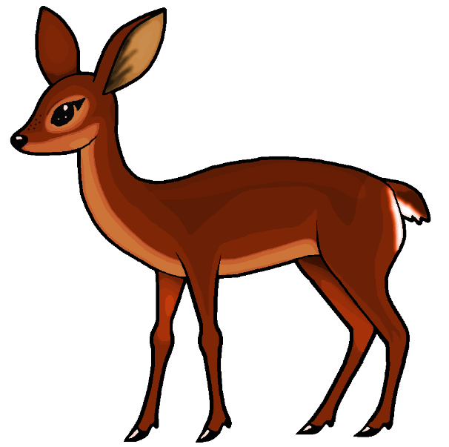
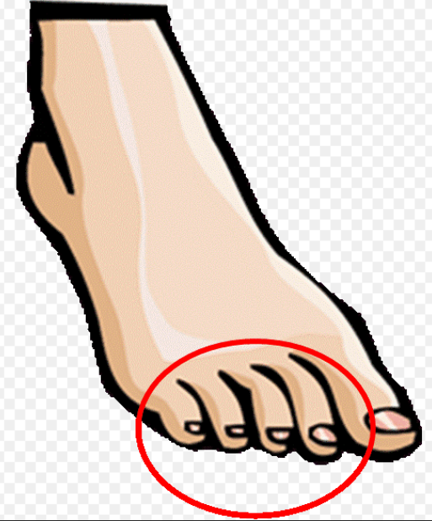
Apply
Segmenting to spell
Practise spelling words containing ‘oe’. Can you write the words to match these pictures?
oe

Slide 51
Apply
Segmenting to spell
How did you do?
Reach for the stars – Can you write the words in a sentence?
oe
doe
toes
hoe

Slide 52
Apply
Reading Books
Blend to read the words in this Collins Big Cat book.

Slide 53
Friday

Slide 54
Revisit and Revise Practise reading these ‘flash words’
will
when
ask
full
like
push
pull

Slide 55
Revisit and Revise Practise reading these ‘off by heart’ words’
your
friend
house
once
today
little

Slide 56
Revisit and Revise
Practise reading these graphemes.
ee
igh
air
ear
oa
ure
oo
Can you find them on your Big Cat chart?

Slide 57
Teach
Look at the new grapheme.
Say it!
Say it to the window, say it to the door, say it to the ceiling, say it to the floor.
Look at it. Use your magic finger to write it in the air.
ue
This grapheme can make two sounds:
as pronounced in the word ‘blue’ or ‘rescue’

Slide 58
Teach
Look at the new grapheme
‘ue’ likes to come in the middle or at the end of words.
ue

Slide 59
Practise reading these words.
Practise
My turn ...
Together ...
Your turn ...
fuel
true
glue
Cover the word and reveal it 1 sound at a time. As you see a sound say it and add it to what you have read already.
blue
cruel
rescue
Word building
Smooth blend
due
clue
argue

Slide 60
Practise
Blending to read
Practise blending words containing ‘ue’ by playing ‘Dragon’s Den’ on ‘Phonics Play’.

Slide 61
Apply
Blending to read sentences
Is it true that it is never cold in Summer?
What is the value of the statue in the garden?
I will use glue and tape to make a model of a plant.

Slide 62
Friday Afternoon

Slide 63
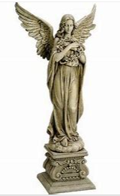
Apply
Segmenting to spell
Practise spelling words containing ‘ue’. Can you write the words to match these pictures?
ue

Slide 64
Apply
Segmenting to spell
How did you do?
Reach for the stars – Can you write the words in a sentence?
ue
blue
glue
statue

Slide 65
Apply
Reading Books
Blend to read the words in this Collins Big Cat book.

